Slide 1
Libertarian Cosmopolitanism
Steven Horwitz
IHS: Morality, Capitalism, and Freedom
Summer 2010

Slide 2
Libertarian Cosmopolitanism
How does classical liberalism or libertarianism approach questions of internationalism and difference?
Beyond “tolerance of difference” to recognizing its benefits
Immigration
Population
Free trade

Slide 3
Immigration
“They took our jobs?”
More people means different people
“Fixed pie” of jobs?
Jobs that wouldn’t exist otherwise
Labor market regs make this harder
Do national borders matter for rights?

Slide 4
Immigration & the Welfare State
Are immigrants (legal or illegal) a drain on tax dollars?
Do they consume more gov’t services than they pay in taxes?
If true, what’s the problem? Immigration or the welfare state?
In fact, not true: most studies show they pay more than they consume
Not just income and SS taxes, but sales and property too.

Slide 5
Population
Are people net consumers or producers?
Hungry mouths vs. producing hands and thinking brains
More people means more different people, means more things can get done.
We wouldn’t have what we have without the population we have.
Population growth turns out to be self-limiting.

Slide 6
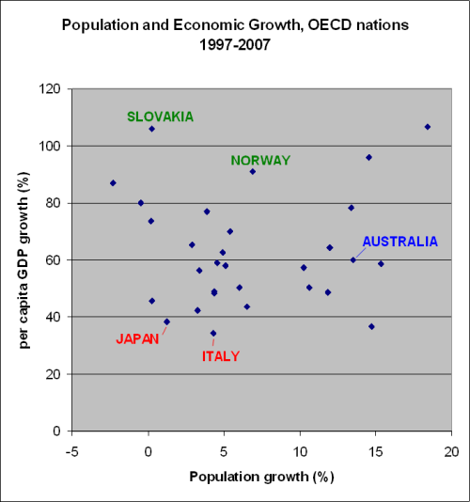
Population and Economic Growth
No empirical relationship between pop growth and economic growth
Key: institutions
Rule of law
Private property
Markets
Channels population into economic growth

Slide 7
Limits to Population Growth
Humans self-limit their population growth
As wealth increases, particularly through industrialization, family size shrinks
Recall: kids become costlier
Key is institutions again
Almost all countries seeing slower growth rates
W. Europe and Japan seeing negative ones
Can’t just extrapolate past patterns – we are not amoeba

Slide 8
Free Trade and Peace
“It is through exchange that difference becomes a blessing, not a curse.” – Rabbi Jonathan Sacks
Comparative advantage, specialization, and exchange
Interdependence and the costs of conflict
The “Law of Association” and cooperation
Free trade as the path to peace
The red herring called the “trade deficit”
Classical liberalism is not isolationist

Slide 9
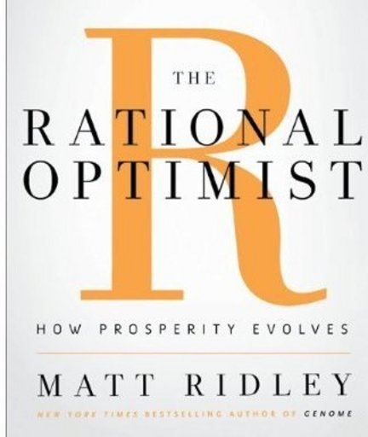
Cosmopolitan Rational Optimism
Classical liberalism:
Open
Optimistic
Confident
Not fearful of change and of difference
We are “rational optimists” about the human condition and other humans.

